Slide 1
Part 1: IPsec Basics
Recommended reading: Stallings, Chapter 16
(RFCs are perhaps a bit too complex and extensive for our class – use as extra reading material)

Slide 2
A parenthesis VPNs: what they are
Perhaps out of scope, here, as VPN and IPsec are NOT the same – more later

Slide 3
Virtual Private Networks: why?
Corporate office Paris
160.80.80.0/24
Corporate office London
160.80.81.0/24
Dedicated P2P line: too costly
Corporate office Paris
160.80.80.0/24
Corporate office London
160.80.81.0/24
Public Internet or operator IP network:
Emerging issues:
How to manage private address space across distributed sites?
How to protect data in transit (especially if public Internet)?

Slide 4
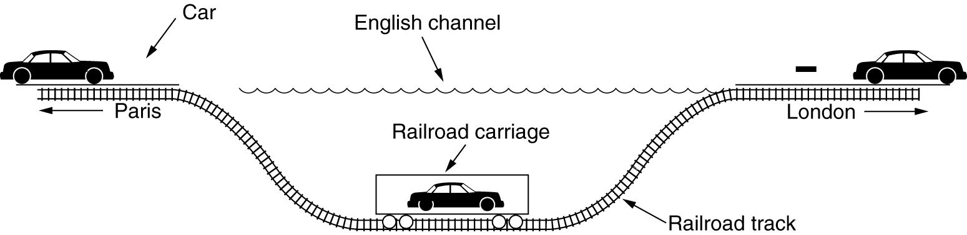
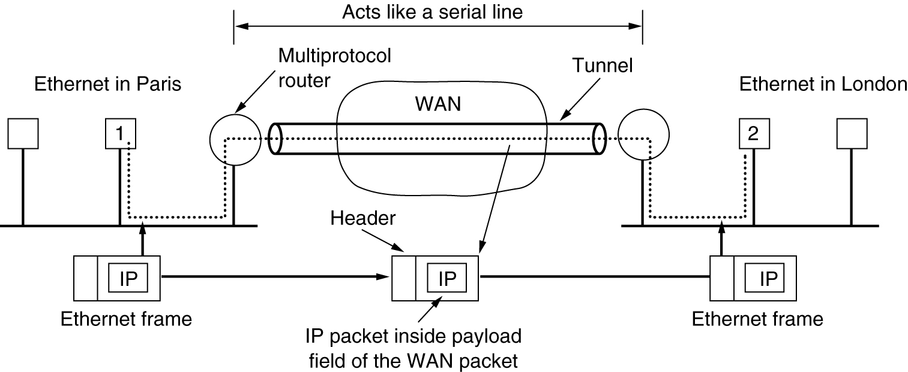
VPN main ingredient → tunnels

Slide 5

VPN main ingredient → tunnels
Incapsulate
Decapsulate
IP D:89.2.3.4
IP d:160.80.81.6
IP D:160.80.81.6
IP d:160.80.81.6
212.1.1.1
89.2.3.4
160.80.80.2
160.80.81.6
IP in IP tunnels
Not the most effective approach!
MPLS tunnels by far more performance effective
Typical VPN offer from today operators
MPLS tunnels alone = no crypto protection
Trust: in the Operator’s infrastructure

Slide 6
VPN 2° ingredient → encryption
encrypt
decrypt
IP
encrypted
IP
DATA
IP
DATA
GW to GW basis
encrypt
decrypt
IP
encrypted
IP
encrypted
IP
encrypted
End-To-End Basis

Slide 7
VPN and IPsec
IPsec: a POSSIBLE tool for building VPN
But IPsec and VPNs are NOT synonymous
as some beginner might think
IPsec VPNs not viable when non-IP traffic must be transported!
IPsec: not only tunnels; also e2e encrypted/authenticated transport
VPN alternatives:
Layer 2: GRE/PPTP, L2TP
Layer 3 (actually 3-): MPLS
Layer 4 (actually between 4 and 7): (D)TLS tunnels
Layer 7: SSH tunnels

Slide 8
IPsec Components

Slide 9
IPsec: layered view
HTTP
SMTP
……
https
HTTP
SMTP
……
SSL / TLS
TCP/UDP
TCP/UDP
IPsec
IP
Network layer security
Transport layer security
IPsec operates with & within IP, at layer 3
IPsec & unprotected IP packets do coexist (of course)
Applications/terminals unaware of IPsec
IPsec protects all protocols that rely on IP
Protection on a per-host (IP) basis
cannot protect SPECIFIC users/applications

Slide 10
IPsec implementation approaches
……
Inside the native IP code
Best approach
But hard to deploy as requires to access and modify IP source code
Bump in the Stack (BITS)
Between native IP code and device driver
Deployed in legacy systems
Bump in the Wire (BITW)
Implemented in dedicated hardware
External security processor, acts as gw
HTTP
SMTP
TCP/UDP
IP/IPsec
Ethernet
……
HTTP
SMTP
TCP/UDP
IP
IPsec
Ethernet
HTTP
SMTP
…
TCP/UDP
IP
IPsec
Ethernet
Ethernet

Slide 11
IPsec standardization History
Three major “series” of RFCs
Serie 1: RFC 1825-1827 (august 1995)
IPsec concepts first drafted
Serie 2: RFCs 2401-2412 (november 1998)
Significant revision of ALL the IPsec architecture
Describes IPsec as we know it today
Serie 3: RFC 4301-4307 (december 2005)
Born after long discussion in WG (almost 5 years)
basically touches/extends all the IPsec architecture
Most important: major revision of IKE (Internet Key Exchange protocol)
IKEv2 simplifies and glues several protocols (ISAKMP, IKE, Oakley) into one
Lots (!) of RFCs – see RFC6071 for a snapshot of IPsec- and IKE-related RFCs

Slide 12
IPsec RFCs
IPsec Architecture Security Association concepts
RFC 4301
Security Protocols
AH
Authentication Header RFC 4302
ESP - Encapsulation Security Payload
RFC 4303
Crypto Algorithms for AH & ESP – RFC 4305
Automatic Key management The Internet Key Exchange (IKEv2) protocol
RFC 4306
Crypto Algorithms for IKEv2 – RFC 4307

Slide 13
Security Association
Fundamental concept in IPsec
May involve:
Host to host
Host to intermediate router (security gateways)
Security gateway to security gateway
Defines the boundaries for IP packets authentication/encryption
A “connection” with security services active

Slide 14
Security Parameters Index and Security Association DB
SAD
SPI
32 bit index
Used to lookup the SAD at destination
Lookup also uses
destination address
source address
security protocol (AH/ESP)
Retrieves algorithms and parameters that allow to process received packet

Slide 15
SA: monodirectional!
SAD
SA1
SAD
SA2
SPI = Security Parameters Index
32 bit “name” of an SA
Destination Address based
Security Association managed at the receiver side
SAD = Security Associations Database
SPI = search key (at least)
But IPsrc and Ipdest can also be used in the (non trivial) lookup
Stores set of security services per each SA, and related parameters
E.g. which encryption algorithm; shared key for encryption, SA lifetime, Sequence number counter, etc

Slide 16
Security Association and Key management
Manual
Manually configure each SA and related crypto keys
static, symmetric
Typical in small-scale VPNs
Few security gateways, e.g. one per site
Meshed SA connections
Automatic
SA management through IKEv2
On-demand SA creation
Session-oriented keying/rekeying

Slide 17
Ipsec security protocols
Authentication Header
Integrity and data origin authentication
Authentication covers both payload and parts of IP header that do not modify in transfer
Protection against replays
Optional, through extended sequence numbers
Encapsulated Security Payload
Same services as AH
Though authentication limited to IP payload
Confidentiality through encryption
Traffic flow confidentiality
Improved privacy against eavesdropping
Through padding and dummy traffic generation

Slide 18
IPsec Security protocols
AH (Authentication Header)
Authentication (whole packet, including IP header) only
ESP (Encapsulated Security Payload)
Payload-only protection (no IP header!)
Encryption, Authentication, both, AEAD
ESP in most cases is the only one needed
Mandatorily supported in any IPsec implementation, unlike AH
RFC 4301: AH downgraded: from MUST to MAY (be supported)
Quoting from RFC 4301: “Experience has shown that there are very few contexts in which ESP cannot provide the requisite security services. Note that ESP can be used to provide only integrity, without confidentiality, making it comparable to AH in most contexts.”
AH and ESP may be combined together, if needed (rarely)
Transport mode and tunnel mode for both

Slide 19
Transport vs Tunnel – AH and ESP
Original IP packet
IP header
TCP/UDP header
Application data
authentication
IP header
AH
TCP/UDP header
Application data
Transport mode
authentication
encryption
IP header
ESP hdr
TCP/UDP header
Application data
ESP trl
ESP auth
authentication
new IP header
AH
IP header
TCP/UDP header
Application data
Tunnel mode
authentication
encryption
new IP header
ESP hdr
IP header
TCP/UDP header
Application data
ESP trl
ESP auth

Slide 20
Authentication Header
0
3
7
15
31
Version
Header
length
Type of Service
(DSCP+ECN)
Total Length
16 bit identification
flags
3 bit
13 bit fragment offset
Time to Live
TTL
Protocol=51
Header checksum
32 bit source IP address
32 bit destination IP address
Variable, if any
Options (if any)
Next Header
AH Payload length
(SN+ICV in 32 bit w)
RESERVED (all 0)
Security Parameters Index (SPI)
Sequence Number field
AH
len
Integrity Check Value (ICV)
variable
DATA (if tunnel mode: IP header + DATA) (if transport mode: TCP, UDP, other)

Slide 21
Transport mode, tunnel mode
Transport mode:
Authentication except mutable fields
mutable proc.
immutable processing
IP header
IP options
AH
TCP/UDP header
Application data
Protocol=51 (AH)
Next Header = 6 (TCP), 17 (UDP), other for other protocols
Tunnel mode:
Authentication except mutable fields
mutable proc.
immutable processing
new IP header
New IP options
AH
IP header
IP options
TCP/UDP header
Application data
Protocol=51 (AH)
Protocol= 6 (TCP), 17 (UDP), other for other protocols
Next Header = 4 (IPv4)

Slide 22
Integrity Check computation
Only on immutable fields in the IP header
Or mutable but predictable
e.g. destination address with strict/loose source routing option
Mutable fields set to 0 during MAC computation
Highlighted in red in next figure
Note: AH apply before fragmentation, and checked after reassembly
Options classified as either mutable or not
Mutable options: details in appendix A RFC 4302
mutable options = all zeroed
Version
Header
length
Type of Service
(DSCP+ECN)
Total Length
16 bit identification
flags
3 bit
13 bit fragment offset
Time to Live
TTL
Protocol=51 (AH)
Header checksum
32 bit source IP address
32 bit destination IP address

Slide 23
Why sequence number?
IP header DOES NOT contain a sequence number!
Hence replay of an authenticated IP packet is possible
And may alter in an umpredictable manner the overlaying service (e.g. ICMP replies can be dangerous ☺)
Sequence number: 32 bit counter
Initialized to 0 when the Security Association is established
Increments of 1 per each transmitted packet
First transmitted packet: SN=1
Maximum value 2³²-1, afterwards Security Association must be terminated
No counter cycling allowed when anti-replay service active
Anti-replay: optional (but default = on)
Anti-replay typically OFF when manual (static) keys configured

Slide 24
Extended Sequence Number
2³² ~ 4.3 billion
A lot, but not REALLY al lot!
Packet size = 1500 (1460 bytes payload)
2³² x 1460 bytes = 6270 GB
About 14 h transmission of a 1 gbps link
Extended Sequence Number:
64 bits - this should be enough, now ☺
Transmit only low order 32 bits
But use high order 32 bits in ICV computation!

Slide 25
Anti-replay
Sliding Window W
Size locally decided at receiver
Minimum = 32; default = 64; higher values recommended for high speed links
eventually very large: maximum 2³¹-1 with SN and 2³²-1 with ESN
Window right margin = highest NS packet received
Duplicates discarded
Packets out of left window edge discarded
Packets greater than right window margin make W shift
Window W
Discard
Accept if ICV OK
Accept if ICV OK and shift window

Slide 26
Encapsulated Security Payload
0
3
7
15
31
Version
Header
length
Type of Service
(DSCP+ECN)
Total Length
16 bit identification
flags
3 bit
13 bit fragment offset
Time to Live
TTL
Protocol=50
Header checksum
32 bit source IP address
Variable, if any
32 bit destination IP address
Options (if any)
Security Parameters Index (SPI)
auth
Sequence Number field
Payload DATA
crypt
Padding (0:255 bytes)
trl
variable
Pad length
Next Header
Integrity Check Value (ICV)

Slide 27
Transport mode, tunnel mode
Transport mode:
Authentication
encryption
IP header
IP options
ESP
hdr
TCP/UDP header
Application data
ESP
trl
ESP
ICV
Protocol=50 (ESP)
Next Header = 6 (TCP), 17 (UDP), other for other protocols
Tunnel mode:
Authentication
encryption
new IP header
New IP options
ESP hdr
IP header
IP options
TCP/UDP header
Application data
ESP
trl
ESP
ICV
Protocol=50 (ESP)
Protocol= 6 (TCP), 17 (UDP), other for other protocols
Next Header = 4 (IPv4)

Slide 28
When transport? When Tunnel?
Transport mode: end-to-end
Security Gateways can use transport mode only for connections originating/terminating there
Not when they are intermediary between host and server!
Tunnel mode used in almost all the cases
But could be also tunnel mode
Transport mode
Tunnel mode

Slide 29
A note on host-to-gw tunnels
Corporate Intranet
160.80.0.0/16
Remote Worker
Outer IP address: public – 213.1.1.4
Inner IP address: private – 160.80.80.34 (/24)
typically assigned by the security GW
Using a private IP address inside the tunnel:
Allows to access to all services provided in the intranet, exactly like in the case the worker is connected inside the corporate
Allows to be protected by the corporate firewall (all traffic destined to 160.80.80.34 MUST be first routed to the corporate subnet and then routed to the end user in a protected fashion

Slide 30
IPsec protection & access control
SPD
Security
Policy
Database
Protected Interface
Internal Network with IPsec Security GW;
Host OS with IPsec Host
Unprotected Interface
- The external network
IPsec boundary
BYPASS
Three rules
AH/ESP
PROTECT
DISCARD
SPD specifies:
Which security protocols (AH, ESP) - On which packets/traffic relations
Which mode (tunnel, transport)
Which granularity
single shared tunnel
different tunnels per TCP conn
Outbound Traffic
Inbound Traffic

Slide 31
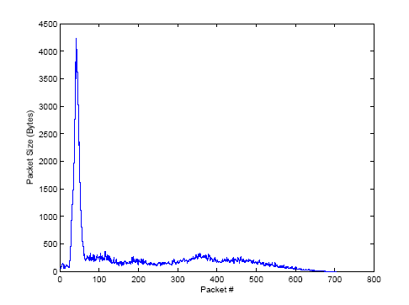
Traffic Flow Confidentiality Service
Encryption does not guarantee unlinkability!
Linkability via statistical traffic pattern analysis
Traffic source (e.g. web-site) fingerprinting
E.g. sample size profile for www.amazon.com
Details in “Privacy Vulnerabilities in Encrypted HTTP Streams, by Bissias, Liberatore, Levine.
Many other traffic/protocol fingerprinting approaches (literature + pre-prints)

Slide 32
ESP Traffic Flow Confidentiality
ESP TFC: Two counter-measures against traffic analysis attacks
Ability to alterate packet size
Supplementary padding facility added to data payload
Easy to manage in tunnel mode, as inner packet size is known in the IP/TCP header
Native (up to) 255 bytes padding insufficient
And why messing up by mixing TCF padding with that necessary for encryption?
Ability to generate “dummy” packets
Next Header = 59 → Dummy packet!!
Example: one can transform a VBR traffic into CBR
Heavy on the network load, though: reduces statistical multiplexing effectiveness
DATA PAYLOAD
IV
(variable)
TFC PADDING

Slide 33
Part 2:
IKEv2
Note: minor updates in RFC 5996, following material based on RFC 4306

Slide 34
Rationale for IKE
shared state must be maintained between source and sink
Which security services (AH, ESP)
Which Crypto algorithms
Which crypto keys
Manual maintenance not scalable
Partially OK only for small scale VPNs
In any case, weak approach
Infinite lifetime SA → no rekeying!
IKE = Internet Key Exchange protocol
Goal: dynamically establish and maintain SA
IKE now (2010, RFC 5996 → 2014, RFC 7296) in version 2
Replaces protocols specified in RFCs 2407, 2408, 2409 (IKE, ISAKMP, DOI)
extends IKEv2 in RFC 4306
IKEv2 quite different (and much cleaner!!) than former specifications

Slide 35
IKE phases at a glance
Peer initiator
Peer responder
IKE_SA_INIT
IKE_SA_INIT
Formerly (IKEv1) referred to as phase 1
IKE_AUTH
IKE_AUTH
Output:
Create one SA for IKE
Create one “child” SA
ONLY if needed:
CREATE_CHILD_SA;
INFORMATIONAL;
….
(any order, any number, any direction)
Formerly (IKEv1) referred to as phase 2

Slide 36
IKE SA and CHILD SA
IKE SA:
Security association to exchange IKE messages (control messages)
CHILD SA
Security association to exchange data messages
Making use of AH or ESP
Many CHILD SA may be set up between two peers

Slide 37
IKE message format
UDP encapsulated
Ports 500 and/or 4500
Reliable delivery managed by IKE through retransmission
A new important feature of IKEv2!
No details here… see RFC 4306 for a thorough discussion
IKE header first
Followed by one or more IKE payloads
Brilliant idea (for a perhaps stretched analogy think to AVP concept; a more appropriate analogy is with the next header concept of IPv6)
flexible approach: new payloads added at later stages
Standard IP header
UDP header
IKE header
Payload 1
Payload 2
…
Payload
next payl
next payl
next payl
next payl

Slide 38
IKE hdr, generic payload hdr
0
3
7
15
31
IKE_SA initiator SPI (8 bytes)
IKE_SA responder SPI (8 bytes)
Next Payload (1B)
major ver
minor ver
Exchange Type (1B)
0
0
0
I
V
R
0
0
Message ID (4 bytes)
Length including IKE header (4 bytes)
Next Payload (1B)
C
RESERVED
Payload length (including this hdr)
Payload body (variable, depends on which payload type)
… … … … … … … … … … … …
Critical bit: if 1 reject if do not understand; if 0, just ignore if you do not understand

Slide 39
IKE header (explanation)
0
3
7
15
31
IKE_SA initiator SPI (8 bytes)
IKE_SA responder SPI (8 bytes)
Next Payload (1B)
major ver
minor ver
Exchange Type (1B)
0
0
0
I
V
R
0
0
Message ID (4 bytes)
Length including IKE header (4 bytes)
Initiator SPI, responder SPI:
SA id for the IKE protocol. Initially, responder SPI set to 0; responder fills it in
don’t confuse with the SPI for the CHILD AH/ESP SA
Versions: major = 2, minor = 0
Bit V=1 says that implementation can “speak” higher version than what written in the hdr
Exchange type: one of 4 messages: IKE_SA_INIT, IKE_AUTH, CREATE_CHILD_SA, INFORMATIONAL
Direction: bit R (response=1, request=0); bit I (original initiator=1, original responder=0; needed to properly match SPIs
Message ID: Sequence number counter, to match requests with responses, to manage retransmission, to combat replay attacks

Slide 40

Version bit Protection against version rollback
Different approach than SSL: based on V (version) flag
REGULAR HANDSHAKE
Version N (V=0)
Version N
Version N-1 (V=0)
Version N-1
Version N-1 (V=1)
Authenticated
N-1 OK
Maximum of my peer
N-1 OK
Maximum I can speak
Version N-1 (V=0)
MITM HANDSHAKE
Version N (V=0)
Version N-2 (V=0)
Version N
Version N-2 (V=0)
Version N-2 (V=1)
Version N-1
Version N-2 (V=1)
Authenticated
N-2 & V=1??
STOP
N-2 & V=1??
STOP
Version N-2 (V=1)
Too bad v1 does NOT include this flag!!! (Hence rollback to IKEv1 is not protected)

Slide 41
IKE_SA_INIT phase
Clear Text Request followed by Clear Text response
Negotiates security parameters for the IKE_SA
sends nonces
sends Diffie-Hellman values
Output:
Generate a session key from which all the other encryption and authentication keys will be generated
Called SKEYSEED

Slide 42
Exchanged Info
Peer initiator
Peer responder
IKE_SA_INIT (SAi1, KEi, Ni)
IKE_SA_INIT(SAr1,KEr,Nr, [CERTREQ])
[…] = optional
SAi1/SAr1 (Security Association) payloads:
Initiator sends list of crypto algorithms supported
SAr1 choose one algo per each function (encryption, authentication, pseudo-random function)
KEi/KEr (Key Exchange) payloads:
Diffie-Hellman Ephemeral values
Ni/Nr payloads:
Random values used in the crypto parameters derivation, to protect replay
At least 16 bytes, up to 256 bytes
CERTREQ (optional payload)
Request of a certificate

Slide 43
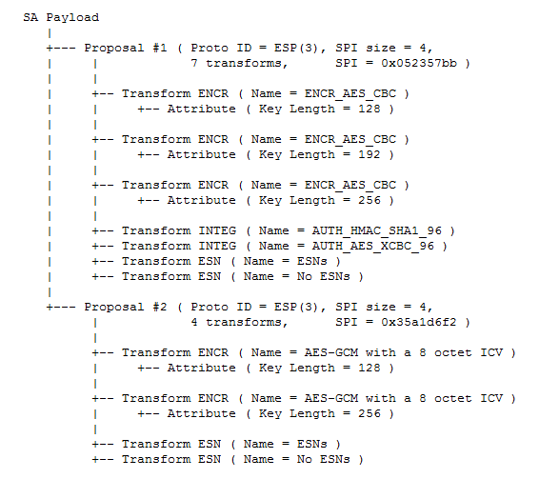
Security Association Payload example

Slide 44
Key generation
SKEYSEED:
Contruction based upon a negotiated prf
Note the difference with TLS (where the PRF is explicitly given)
SKEYSEED = prf(Ni, Nr, g^ir)
g^ir = Diffie-Hellman shared key
7 keys generated:
Through prf+ extended construction (similar to TLS)
prf+(SKEYSEED, Ni | Nr | SPIi | SPIr)
SK_{ai} SK_{ar} for authentication at initiator and responder
SK_{ei} SK_{er} for encryption at initiator and responder
SK_{pi} SK_{pr} for generating AUTH payload in SA_AUTH phase
SK_{d} to derive new keys for the CHILD_SA

Slide 45


Protection against DoS attacks
DH computation and key generation is a computational expensive process; state must be memorized
Denial of Service Attack: spoof INIT requests (using forged IP addresses) and overload server (exhaust CPU and memory)
When load is sufficiently high, “Normal” requests cannot be processed anymore
IKE_SA_INIT
IKE_SA_INIT
IKE_SA_INIT
IKE_SA_INIT
IKE_SA_INIT
IKE_SA_INIT
IKE_SA_INIT
IKE_SA_INIT
IKE_SA_INIT
IKE_SA_INIT

Slide 46
Solution: cookie-based 4-way INIT handshake
Peer initiator
Peer responder
HEADER(A,0), SAi1, KEi, Ni
No state memorized
No computation
HEADER(A,0), N(COOKIE)
HEADER(A,0), N(COOKIE), SAi1, KEi, Ni
Perform INIT Handshake
HEADER(A,B), N(COOKIE), SAr1, KEr, Ni, [CERTREQ]
Idea:
Responder first replies with a cookie
Real initiators will reformulate the request including the cookie provided
Only at this point a state (SPI=B) is instantiated
Fools DoS attacks based on spoofed IPs
Typical attacks!

Slide 47
Is this a real solution?
Q: What if DoS attacker spoofs cookies too
E.g. using random cookies?
A: cookies must be “valid”, i.e. issued by the responder
…. but ….
Server must recognize valid cookies
Hence it must store a state for the cookies, e.g. a database
And hence it must use memory!!
… is this true?

Slide 48
Idea: use stateless cookies
Use cookies which do not require any state memorization
i.e. the validity of the cookie may be checked without any lookup at a database of issued cookies, but only looking at the request and at the cookie itself
Example:
where:
Ni, IPi, SPIi is information that is available in the IKE_SA_INIT request (nonce, IP address, SPI)
Ni included to avoid that an attacker who sees only the server response may spoof the INIT+COOKIE message!
<secret> is an information available only at the responder
<secret> changes over time (hence VersionIDofSecret initial label)
Refresh to avoid build up of cookie dictionaries
Cookie = <VersionIDofSecret> | Hash(Ni | IPi | SPIi | <secret>)

Slide 49
IKE_AUTH phase
Peer initiator
Peer responder
IKE_AUTH (IDi, [CERT], [CERTREQ], [IDr], AUTH, SAi2, TSi, TSr)
IKE_AUTH (IDr, [CERT], AUTH, SAr2, TSi, TSr)
IKE message Encrypted and authenticated, except IKE header
Using previously derived SKe as encryption key
Using previously derived SKa as authentication key
Using previously negotiated encryption/authentication algorithms
Sends AUTH payload
Authenticates previous message + Identity of initiator and responder (IDi, IDr – could be IP addresses, domains, email addresses or else)
Combats downgrade attacks
When certificates exchanged, authentication uses corresponding private key

Slide 50
CHILD_SA generation
First CHILD_SA directly incorporated in AUTH messages
Transmits new Security Association payloads to negotiate security parameters for the CHILD_SA
Transmits the Traffic Selector (TS) parameters, i.e. the IP addresses, port numbers & protocols to which the SA must be applied
E.g. IP addresses in the range 192.168.1.1-12
TS parameters included in the Security Policy Database
Other CHILD_SA may follow
Further include new nonces

Slide 51
INFORMATIONAL
Notification messages
Configuration messages
E.g. assign internal IP address to remote terminal tunneled into an IPsec SA
Report error conditions
Empty INFORMATIONAL payload = check for liveness

